Slide 1
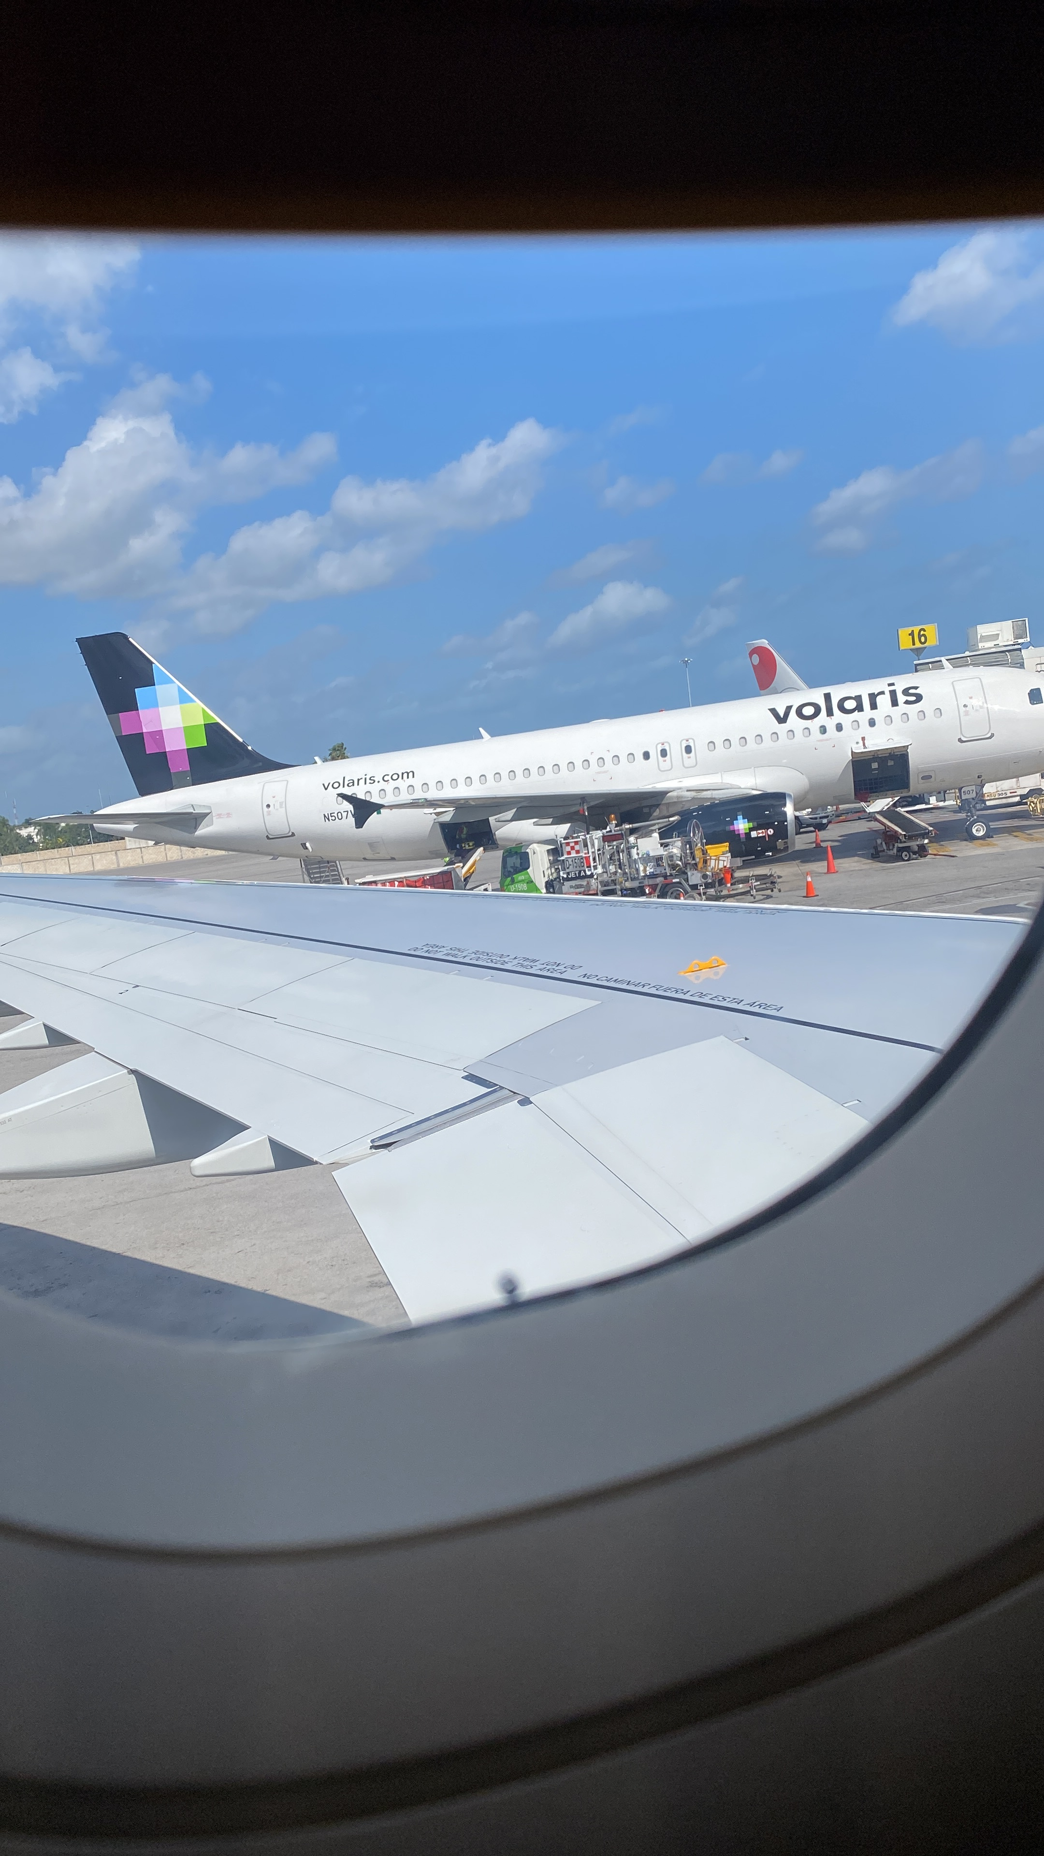
I traveled to Tokyo Japan.
Juan Pablo Osorio Pérez

Slide 2
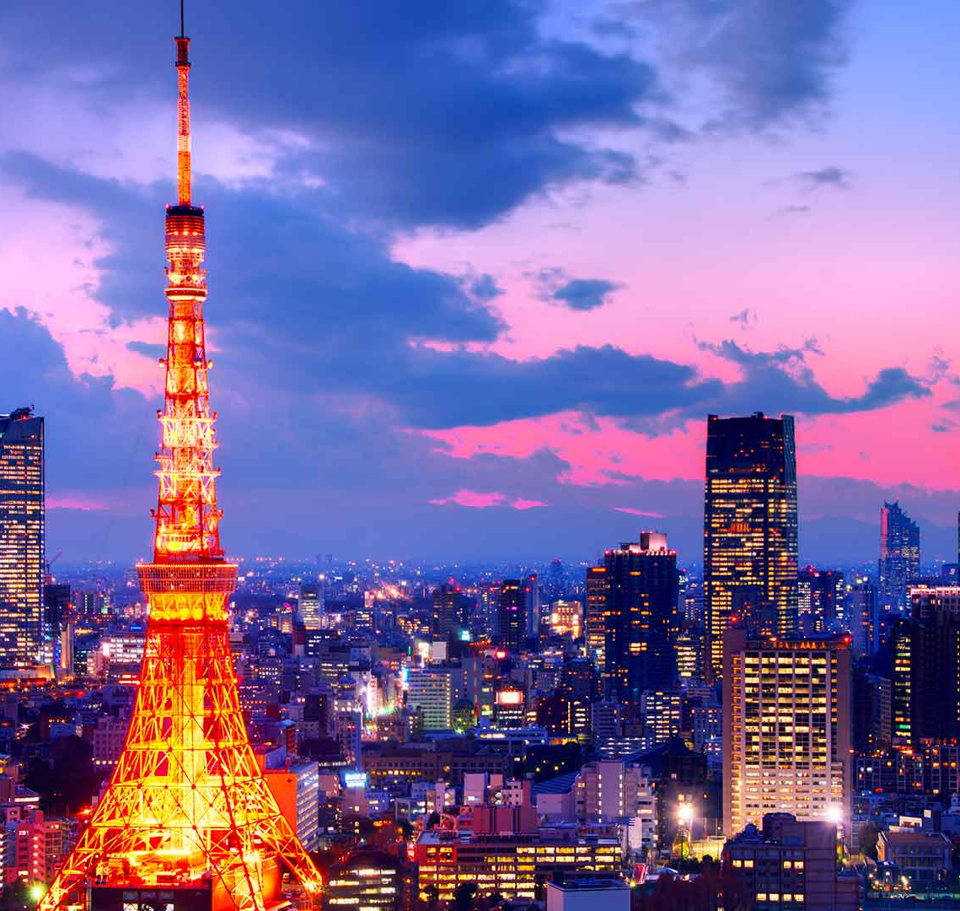
I visited Tokyo Tower
.

Slide 3
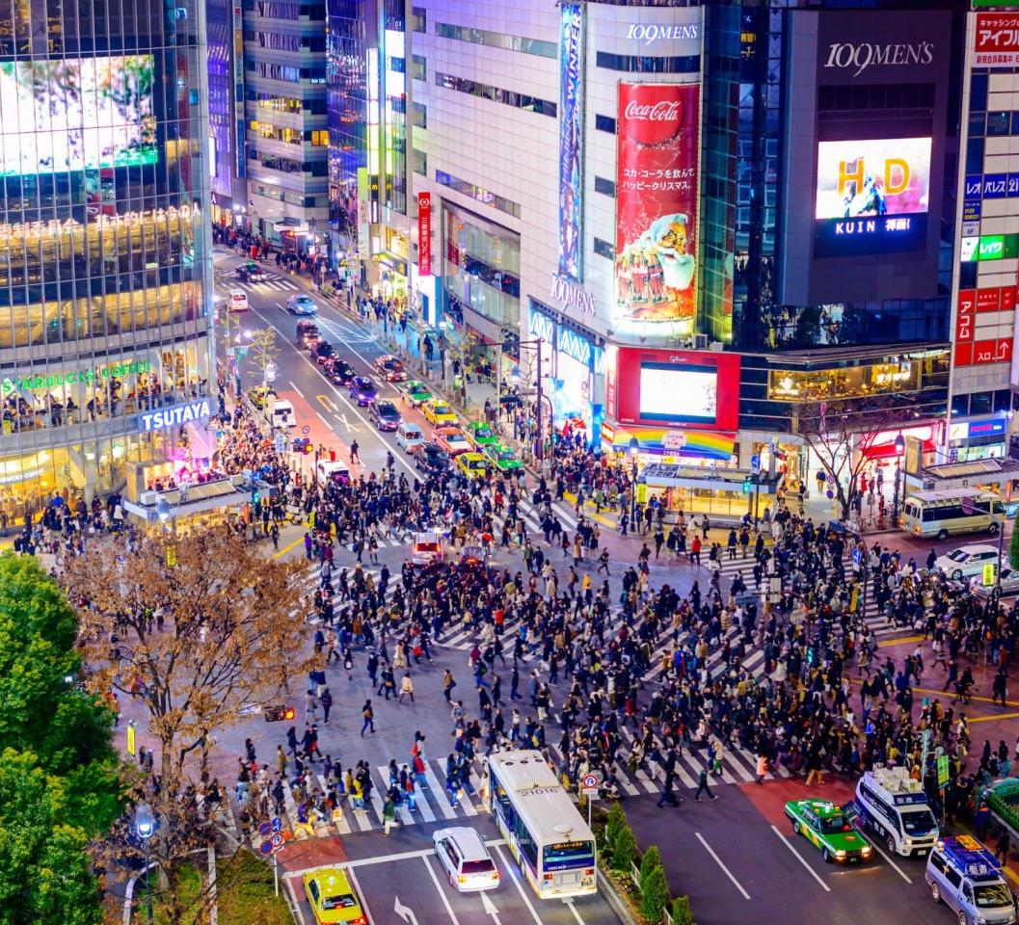
Famous Intersection

Slide 4
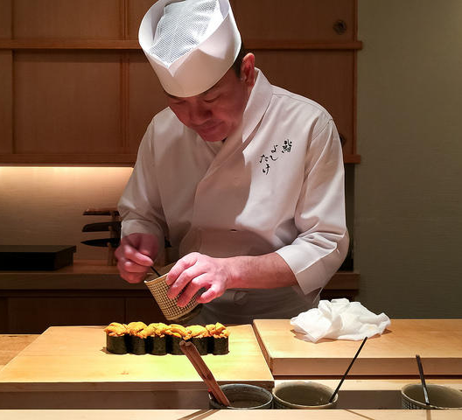
Sushi in Ginza

Slide 5
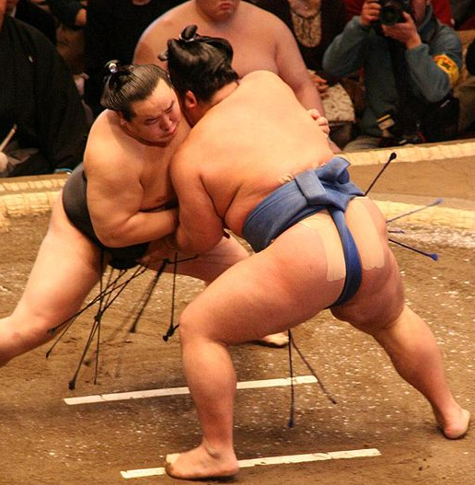
Sumo in Tokyo

Slide 6
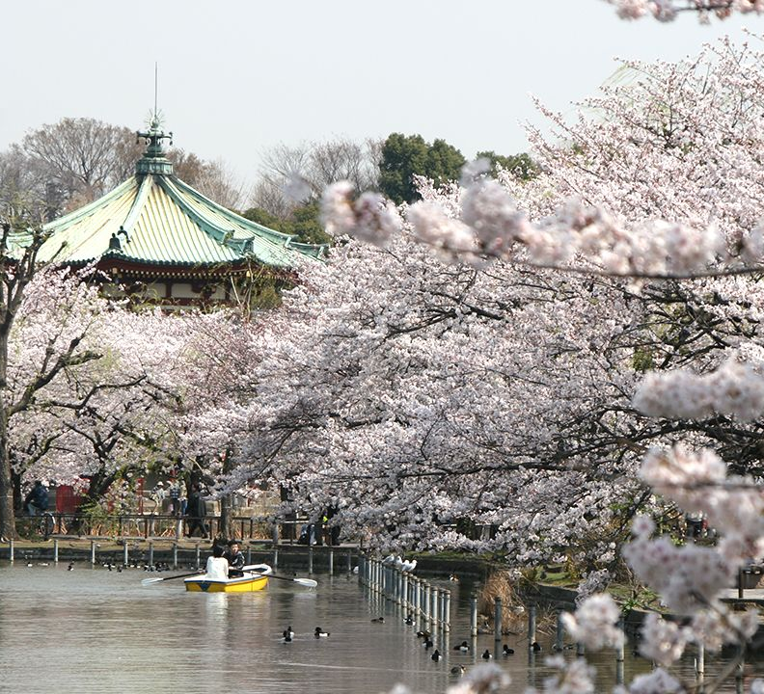
Cherry Blossoms

Slide 7
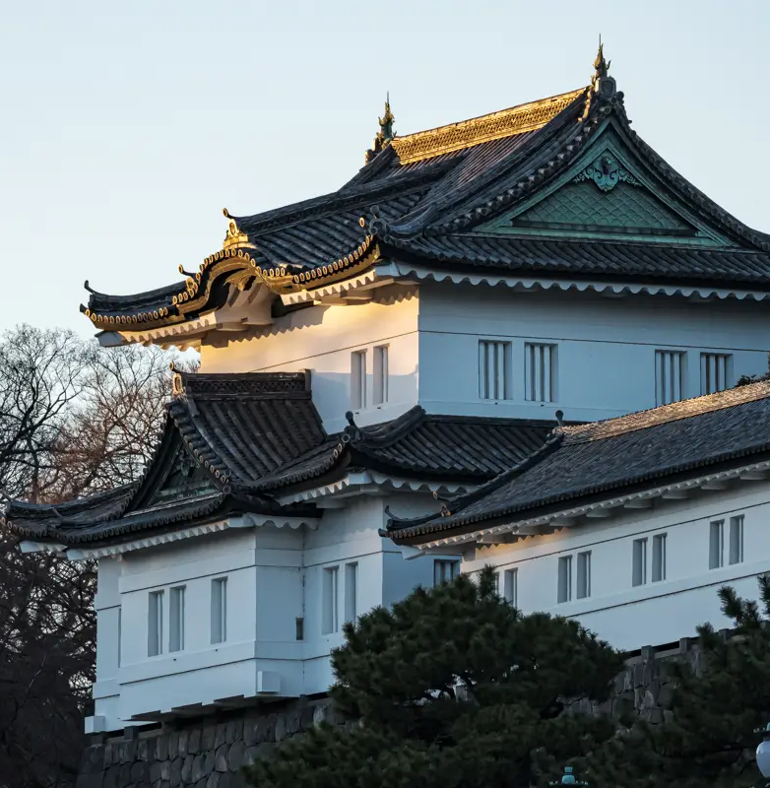
No visited Imperial Palace

Slide 8
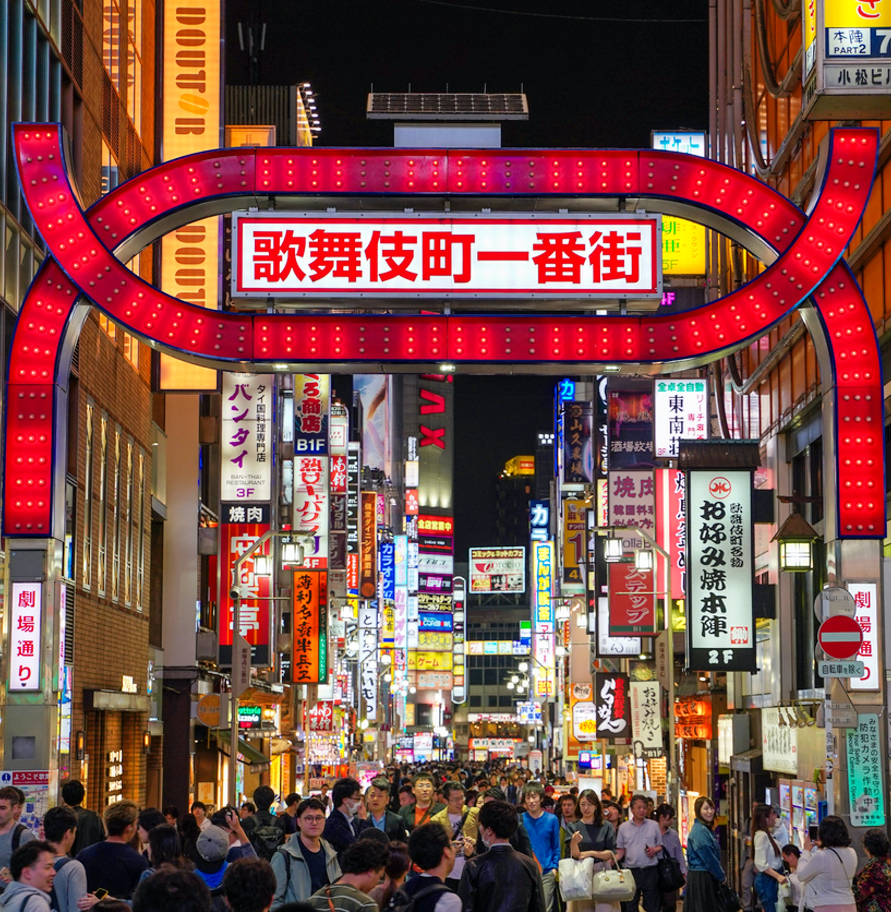
Nightlife in Shinjuku

Slide 9
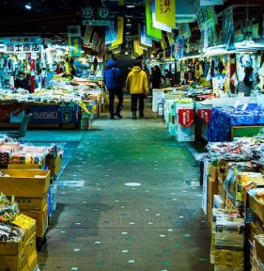
Local markets

